Slide 1
Mindfulness & Stress Reduction
Julianne Haddad LMSW Hamilton School Social Worker

Slide 2
“Make Peace with Uncertainty”
Notes:
This situation is one of extreme uncertainty. We don’t know what will happen, how long it will last or what things will be like when it’s over. One thing we do know, however, is that worrying about it won’t change the outcome. Learning how to tolerate the uncertainty is a huge part of building healthy coping skills for ourselves, which we then want to model for our children. “Right now it’s very easy to let your brain spin out with the frightening possibilities,” warns Dr. Anderson. “Practicing mindfulness helps bring us back to the present, and away from the brink.”

Slide 3
What is Stress?
Stress can be defined as…
…a normal physical response to events that make you feel threatened or upset your balance in some way.
Basically…the point when things appear to be too much to handle
NOT ALL STRESS IS BAD
Stress helps you to deal with life’s challenges, to give your best performance, and to meet a tough situation with focus.
Notes:
Stress helps you to deal with life’s
challenges, to give your best performance,
and to meet a tough situation with focus.
The body’s stress response is important
and necessary. However, when too much
stress builds up, you may encounter many
physical and emotional health problems.
If you don’t deal with stress, the health
problems can stay with you and worsen
over the course of your life.
positive stress occurs when your level of stress is high enough to motivate you to move into action to get things accomplished
negative stress occurs when your level of stress is either too high or too low and your body and/or mind begin to respond negatively to the stressors.

Slide 4
Now, what is stress? Or, how can we notice it?
Physical Symptoms
Low energy
Headaches
Stomachache
Aches/pains
Insomnia
Lowered immune system strength
Nervousness/ jitters
Emotional/
Cognitive Symptoms
Irritable/ agitated
Constant worrying/ anxiety
Poor judgment
Forgetfulness
Difficulty focusing
Avoiding friends/family
Feeling overwhelmed
Behavioral Symptoms
Changes in appetite
Procrastination
Increased use of substances
Visible fidgeting
WebMd, 2019
Notes:
Symptoms could be:
Physical such as headaches or upset stomach
Changes in sleep or eating patterns
You need to learn the ways in which your body signals you that you are experiencing stress, so that you can recognize it and deal with it before it makes you ill
ACTIVITY
What signals does your body send you that you are under stress?

Slide 5
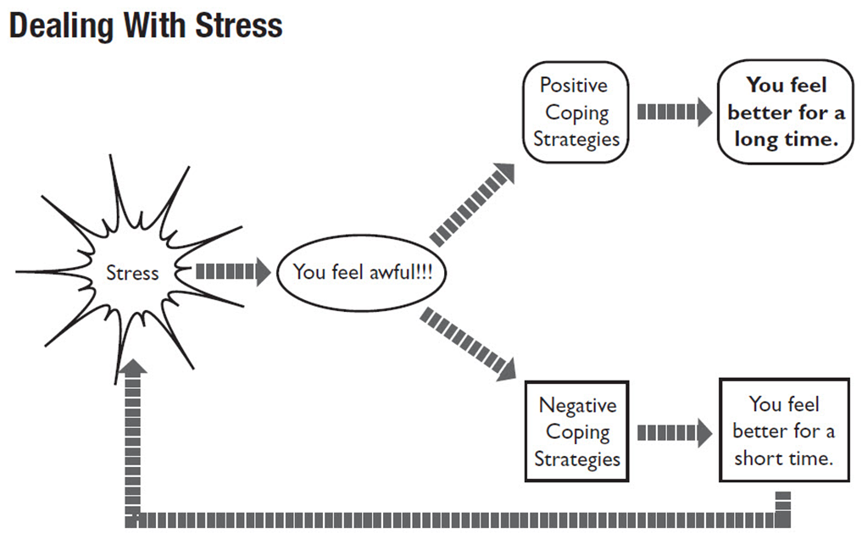
Negative Ways Teens Deal with Stress
Self-medicating
Using drugs or alcohol
Self-injury
Avoidance
Procrastination
Over preforming

Slide 6
Identifying Stressors
Take a moment to think about what type of day you have had? How many stressors – mild or major have you encountered today?
Situations that make you feel stress are called stressors
Not everyone reacts the same way to the same stressors
Recognize your Stressors to help control your stress!
Notes:
Type in the chat stressors you are dealing with

Slide 7
Expect Stress
stress is a given, but being stressed-out is optional.
Notes:
Stress is a normal reaction in the body that creates the necessary nervous system activation to handle a challenging task. It becomes a problem when we never allow that stress to be discharged (either through exercise, or some of the practices listed below).
Research shows that people who expect stress are actually less stressed — when we disabuse ourselves of the silly notion that things will always be easy and our day will generally go as planned, we are more prepared to handle the curveballs life likes to throw at us.
There’s lots of things they can do about it in order to feel better!

Slide 8
What is Mindfulness?
“Mindfulness-Based Stress Reduction (MBSR) is a blend of meditation, body awareness, and yoga: learning through practice and study how your body handles (and can resolve) stress neurologically” (Palouse Mindfulness, 2019).
Essentially, mindfulness uses various techniques to pay attention to the present moment with curiosity & without judgment
Bringing mindfulness into our daily activities as well so we are living in the present moment day to day
Benefits:
Increased empathy and compassion
Improved immune functioning
Increased happiness and optimism
Improved sleep
Greater focus and concentration
Reduced stress and anxiety
Palouse Mindfulness, n.d.; BrilliantMindfulness.com, n.d.

Slide 9
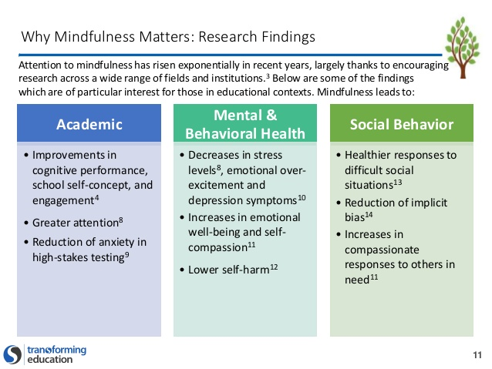
Notes:
So here is why it is so important for you

Slide 10
What is Mindfulness?

Slide 11
How Mindfulness can Help During Covid
Notes:
Take a deep breath. Literally. Feel a little better?
These are trying times, but incorporating mindful practices into your daily routine can help calm anxiety and build healthy coping skills. Here are some tips from our clinicians on making mindfulness work for you and your family.

Slide 12
Mindfulness Doesn’t have to be complicated
Squeeze Muscles
Belly Breathing
Mindful Meal
Meditation
Guided Imagery
Coloring
Listening to music
Notes:
Taking time to focus on the present, being intentional and thoughtful about where you are and how you are feeling. Trying to center your thoughts and be in the moment. Here are some simple activities
Squeeze Muscles: Starting at your toes, pick one muscle and squeeze it tight. Count to five. Release, and notice how your body changes. Repeat exercise moving up your body.
Belly Breathing: Put one hand on your stomach and one hand on your chest. Slowly breathe in from your stomach (expand like a balloon) and slowly breathe out (deflate).
Mindful Meal: Pay attention to the smell, taste and look of your food. No multitasking.
Meditation: Sit in a relaxed, comfortable position. Pick something to focus on, like your breath. When your mind wanders, bring your attention back to your breath.
Coloring: Color something. Focus on the colors and designs.
Listening to Music: Focus on the whole song, or listen specifically to the voice or an instrument.

Slide 13
Guided Imagery

Slide 14
Other areas to be mindful in
What story are you telling yourself?
Notice the good
No emotion lasts forever
Notes:
3. What’s the Story?
A big part of what stresses us out is the story we tell ourselves about what’s happening. Encourage your teen to stop when she is stressed, and ask herself, “What’s the story?” Is she telling herself she’ll fail the test, or that no one likes her? Ask if she can drop the story, and just notice what is actually happening.
Thoughts are incredibly seductive, making us think they are completely true and vitally important. Teens, given their intense, developmentally-appropriate focus on the self, often believe the negative stream of self-critical thoughts in their heads
4. Notice the Good
When we’re stressed, it puts the brain in a fearful state, and therefore we start to pay more attention to threats, which only makes the stress worse! Encourage your teen to notice the things that are good, or even just okay, right now. Challenge her to go through her day and notice ten things that are beautiful, helpful, kind, or pleasant.
No Emotion Lasts Forever
A major component of teen angst is the feeling that “I’ll ALWAYS be miserable.” With mindfulness, we come to understand that no emotion lasts forever. When you pay close attention to it, an emotion is actually a constantly shifting combination of sensations and thoughts and feelings and memories. No two seconds of your emotional experience are identical.
In Amy Saltzman’s A Still Quiet Place for Teens, she encourages teens to “graph” their emotional experience. For example, anger may spike quickly, and then fade slowly, while sadness is more of a gentle sine wave. By tracking their emotion, and attending more to the contours of the experience (how long it lasts, if it’s intermittent or continuous, etc,), as opposed to the content of it, teens come to understand the way that emotions play out in their own bodies. They can actually experience (as opposed to just “knowing”) that emotions are impermanent.

Slide 15
How do I practice?
“What you practice grows stronger.” – Shauna Shapiro

Slide 17
LET’S PRACTICE
Notes:
Talk about how often they should practice

Slide 20
6 Things to ask yourself everyday
1. What am I grateful for today?
2. Who am I checking in on today?
3. What are some expectations of normal that I can let go of today?
4. How am I getting outside today?
5. How am I moving my body today?
6. What beauty am I creating today?

Slide 21
Mindfulness Practices outside of Hamilton
Apps like Calm & Headspace can help your teen (and you!) access meditation and mindfulness techniques anywhere!
Notes:
Anyone else use any good apps?

Slide 22
THANKS!
Any questions?

Slide 23
References
Brilliant Mindfulness. (n.d.). Retrieved from brilliantmindfulness.com
Palouse Mindfulness. (n.d.). Mindfulness-based stress reduction. Retrieved from https://palousemindfulness.com/index.html
WebMd. (2019). Stress symptoms. Retrieved from https://www.webmd.com/balance/stress-management/stress-symptoms-effects_of-stress-on-the-body#2

Slide 24
CREDITS
Special thanks to all the people who made and released these awesome resources for free:
Presentation template by SlidesCarnival
Photographs by Unsplash

